Slide 1
[Organisation] · PHASE D
Networked Computing
and Hardware
Four sites carrying hardware, six carrying only people, and a network topology the repository does not hold
10 sites · 18 nodes · 9 zones and 10 links, none of them recorded
Draft 0.1 · October 2027

Slide 2
PROVENANCE
Half of this is not in the repository
The sites, the nodes and their placement are read. The zones, the links and the external connections are proposed here and exist nowhere else.
Sites
O12 Location, 10 records
Type, city, country, headcount and criticality all recorded.
Read
Hardware nodes
O27 Physical Technology Component, 18 records
Vendor, version, support end date, cost and site all recorded.
Read
Node placement
O27 Location column
Every node resolves to a site. Four sites carry hardware; six carry none.
Read
Network zones
not in the repository
Segmentation within a site. Proposed under CR-042.
Authored
Inter-site links
not in the repository
What connects Midrand to Cape Town, to Azure and to the branches.
Authored
External connections
not in the repository
Brokers, the bancassurance partner, funeral parlours and the regulators all connect somewhere. Nothing records where.
Authored
A topology diagram that mixes recorded and invented facts without marking them is worse than no diagram.

Slide 3
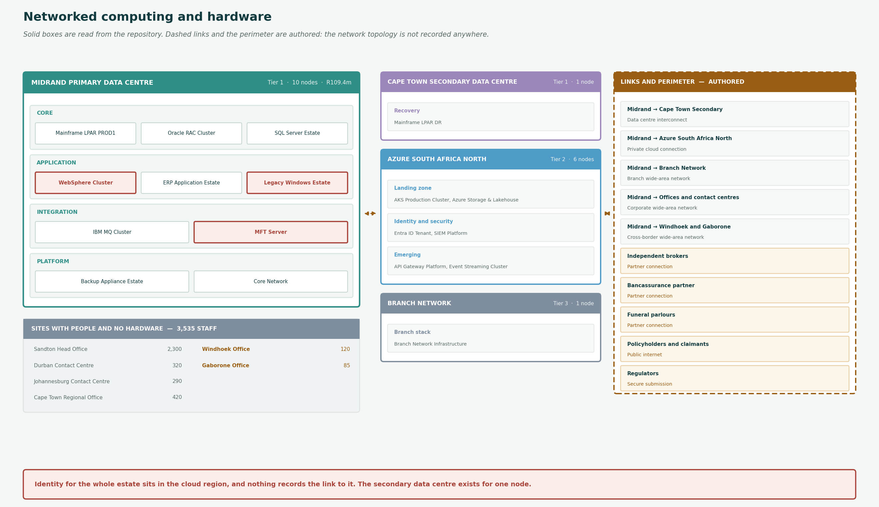
THE TOPOLOGY
4 sites with hardware, 6 with only people
Solid boxes are read from the repository. The dashed perimeter panel is authored. Red nodes are out of vendor support.

Slide 4
SITES
Ten sites, four with hardware
Six carry only people, and two of those are outside South Africa.
Ref
Site
Type
Country
Criticality
Headcount
Nodes
Cost Rm
LOC-01
Sandton Head Office
Office
South Africa
Tier 1
2,300
—
—
LOC-02
Cape Town Regional Office
Office
South Africa
Tier 2
420
—
—
LOC-03
Durban Contact Centre
Contact Centre
South Africa
Tier 1
320
—
—
LOC-04
Johannesburg Contact Centre
Contact Centre
South Africa
Tier 1
290
—
—
LOC-05
Midrand Primary Data Centre
Data Centre
South Africa
Tier 1
40
10
R109.4
LOC-06
Cape Town Secondary Data Centre
Data Centre
South Africa
Tier 1
22
1
R11.4
LOC-07
Azure South Africa North
Cloud Region
South Africa
Tier 2
0
6
R19.9
LOC-08
Branch Network
Branch
South Africa
Tier 3
640
1
R6.1
LOC-09
Windhoek Office
Office
Namibia
Tier 3
120
—
—
LOC-10
Gaborone Office
Office
Botswana
Tier 3
85
—
—
Sandton Head Office has the largest population in the group and no recorded hardware. Windhoek and Gaborone process South African customer data across a border.

Slide 5
LINKS AND PERIMETER
Ten links, none of them recorded
What connects the sites, and who connects from outside. Every row here is authored.
Midrand → Cape Town Secondary
Data centre interconnect
Carries mainframe replication. Nothing else at the secondary site needs it.
Midrand → Azure South Africa North
Private cloud connection
Six nodes in Azure including identity for the whole estate. The connection is load-bearing and unrecorded.
Midrand → Branch Network
Branch wide-area network
640 staff across an unspecified number of branches, on one recorded component.
Midrand → Offices and contact centres
Corporate wide-area network
Four sites, 3,330 people, no local hardware.
Midrand → Windhoek and Gaborone
Cross-border wide-area network
Two foreign sites. The link exists because people work there; nothing records it or what crosses it.
Independent brokers
Partner connection
3,400 brokerages reaching BrokerNet. One of the two external actors that reaches Restricted data.
Bancassurance partner
Partner connection
Reaches BancaBridge and, through it, Advice Record. The second external actor reaching Restricted data.
Funeral parlours
Partner connection
More than 3,000 notify funeral claims. How they connect is not recorded anywhere.
Policyholders and claimants
Public internet
WebQuote and the customer surfaces.
Regulators
Secure submission
Prudential Authority and FSCA. Eighteen days of manual assembly before anything is submitted.
Three thousand four hundred brokerages and more than three thousand funeral parlours connect somewhere. Nothing records where.

Slide 6
FINDINGS
What the topology shows
The network topology is not in the repository
Two network components and ten sites is everything recorded. Zones, links, bandwidth and external connections are authored here.
A hardware diagram is the one artifact where invention is hardest to spot, because a plausible topology looks like a real one. Half of this diagram is read and half is proposed, and the workbook marks every row. It should go into the repository under CR-042 rather than stay as a picture.
The secondary data centre exists for one node
Cape Town Secondary holds the mainframe DR LPAR and nothing else, at R11.4m a year.
The interconnect therefore carries mainframe replication only. Everything else in Midrand, including both database platforms with ten critical dependants each, has no recorded secondary. The site is Tier 1 and the recovery position it provides covers two applications.
Identity for the whole estate sits in the cloud region on an unrecorded link
The Entra ID tenant is at Azure. Every site depends on it and nothing records the connection.
If the Midrand-to-Azure link is the single path to identity, it is the highest consequence link in the estate and it appears nowhere. That is the first thing CR-042 should capture.
Six sites carry 3,535 people and no hardware
Both head offices, both contact centres and both foreign offices.
Four are expected. Windhoek and Gaborone are not, because a Namibian and a Botswanan office working on South African customer data raises a cross-border transfer question under POPIA that neither the location register nor the data architecture can answer.
One component stands for the entire branch estate
Branch Network Infrastructure, at a site recorded as 'Various', serving 640 staff, with eight months of support runway.
How many branches, where they are and what each contains is not recorded. Renewing it is therefore a procurement against an unknown quantity, and it is the fourth platform inside twelve months.
If the Midrand-to-Azure link is the single path to identity, it is the highest consequence link in the estate and it appears nowhere.

